Slide 1
Advanced Data Visualization
Sampling Numerical & Categorical Data

Slide 2
Data Collection
Anecdotal evidence: evidence based on a limited sample size that might not be representative of the population.
For example: My uncle smokes three packs a day and he is in perfectly good health.
Larger samples of cases will show trends (statistical evidence) that make the negative health impacts of smoking much clearer.

Slide 3
Variables
Numerical (quantitative): Take on numerical values. These calculations can be applied to them: add, subtract, average.
Continuous: e.g.: time, distance
Discrete (countable): count data
Categorical (qualitative): Take on a limited number of distinct categories. They can be numbers but without arithmetic operations (eg: 0 male, 1 female)
Regular: morning or afternoon person?
Ordinal (have order level): degree of satisfaction

Slide 4
Relationship between variables
Two variables that show some connection with one another are called associated (dependent). If two variables are not associated, they are independent.
Association can be positive (high implies high) or negative (high implies low).
Correlation is one measure of association (although there are others).

Slide 5
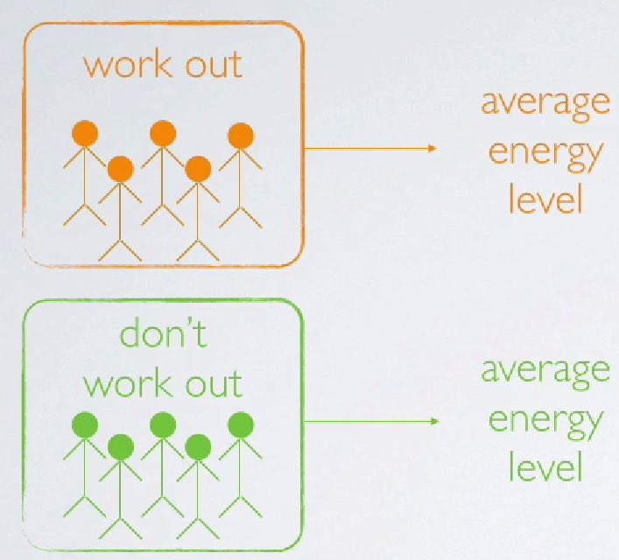
Studies
Observational Study: if we find an association, this does not mean that working out CAUSES a change in energy level. (Maybe people who already have high energy are more likely to want to work out; or maybe some other lifestyle factor influences both desire to work out and energy levels.)
sample
sample
Correlation does not
mean causation.

Slide 6
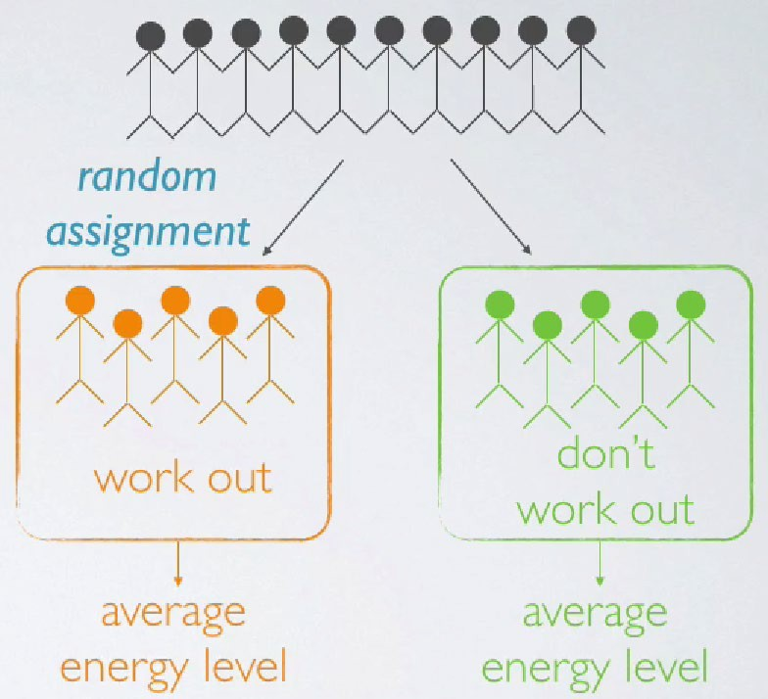
Studies
sample
Experimental Study (Intervention): Now if we find a difference between the two averages, we can probably make a causal statement attributing this difference to working out
intervention

Slide 7
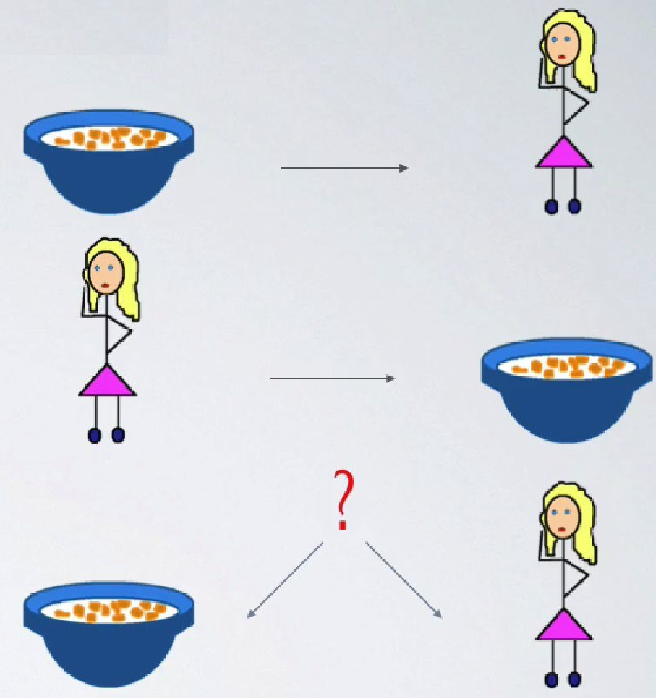
Study (example)
Eating breakfast causes people to be slimmer.
OR: Being slim causes people to eat breakfast.
OR: A third variable is responsible for both? (confounding variable)

Slide 8
Correlation vs. causation
Once again:
Correlation does not imply causation.

Slide 9
Sampling
Sampling studies only a sample, or subset of the entire population.
Some individuals are hard to locate or measure.
Populations rarely stand still.
But a good sample must be representative of the population (must display similar statistics).
But good sampling is difficult, so there are many different methods.

Slide 10

Convenience sample

Slide 11

Non-response

Slide 12

Voluntary response

Slide 13
Sampling Bias
Selection Bias
Occurs when certain groups or individuals in the population are systematically excluded or overrepresented in the sample.
Example: Conducting a survey online might exclude people without internet access.
Effect: The sample does not accurately reflect the population.

Slide 14
Sampling Bias
Nonresponse Bias
Occurs when individuals selected for the sample fail to respond, and their nonresponse is related to the study topic.
Example: People who feel strongly about a political issue are more likely to participate in a survey, skewing the results.
Effect: Results are biased toward the opinions of those who respond.

Slide 15
Sampling Bias
Undercoverage
Happens when some members of the population have no chance of being included in the sample.
Example: A phone survey excluding households without landlines.
Effect: Leads to missing data on specific subgroups.

Slide 16
Sampling Bias
Voluntary Response Bias
Occurs when participation is self-selected, and only individuals with strong opinions (positive or negative) choose to respond.
Example: Online polls where only passionate individuals participate.
Effect: Overrepresents extreme views.

Slide 17
Sampling Bias
Response Bias
Refers to inaccuracies in the responses provided by participants.
Types:
Social desirability bias: Participants give answers they think are socially acceptable.
Acquiescence bias: A tendency to agree with questions regardless of content.
Example: People underreport unhealthy habits in health surveys.
Effect: Skews data away from true behavior or opinions.

Slide 18
Sampling Bias
Survivorship Bias
Occurs when only "survivors" or successful cases are included, overlooking failures.
Example: Studying only companies that succeeded without considering those that failed.
Effect: Leads to overly optimistic conclusions.

Slide 19
Sampling Bias
Recall Bias
Happens when participants are asked to recall past events, and their memories may be inaccurate or incomplete.
Example: Asking patients about symptoms they experienced months ago.
Effect: Results in distorted or unreliable data.

Slide 20
Sampling Bias
Confirmation Bias
Occurs when researchers intentionally or unintentionally select data that supports their hypotheses while ignoring contradictory data.
Example: Including only results that align with expected outcomes.
Effect: Produces misleading conclusions.

Slide 21
Sampling Bias
Attrition Bias
Happens when participants drop out of a longitudinal study, and those who leave differ significantly from those who stay.
Example: High dropout rates in a weight-loss program may leave only successful participants in the study.
Effect: Results reflect only those who completed the study, not the entire sample.

Slide 22
Sampling Bias
Attrition Bias
Happens when participants drop out of a longitudinal study, and those who leave differ significantly from those who stay.
Example: High dropout rates in a weight-loss program may leave only successful participants in the study.
Effect: Results reflect only those who completed the study, not the entire sample.

Slide 23
Sampling Bias
Sampling Bias leads to:
Misrepresentation of the population.
Reduced validity of study conclusions.
Difficulty generalizing results to the broader population.
To minimize these biases, researchers should carefully design their sampling methods, use randomization where possible and account for potential sources of error in their analysis.

Slide 24
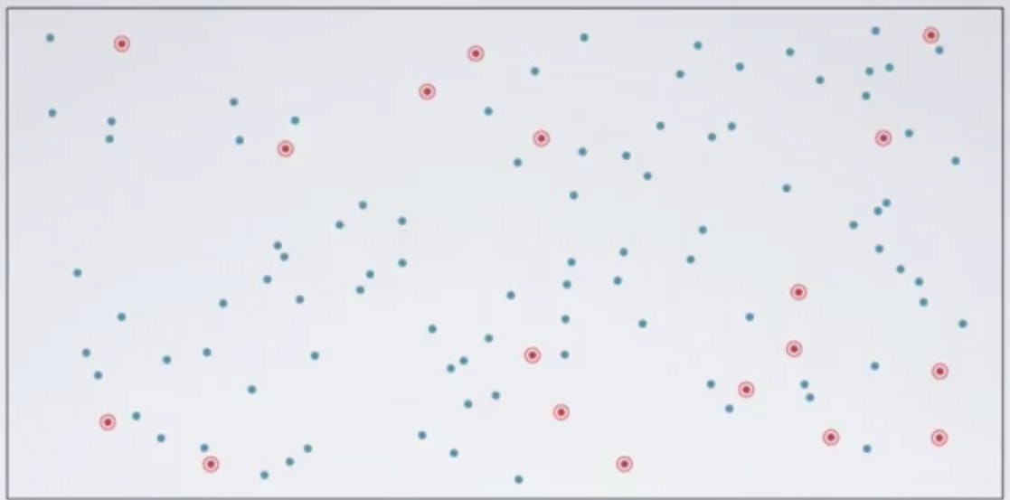
SRS Sampling
Simple Random Sample: Randomly select cases from the population such that each case is equally likely to be selected (ex: draw a name from a hat).

Slide 25
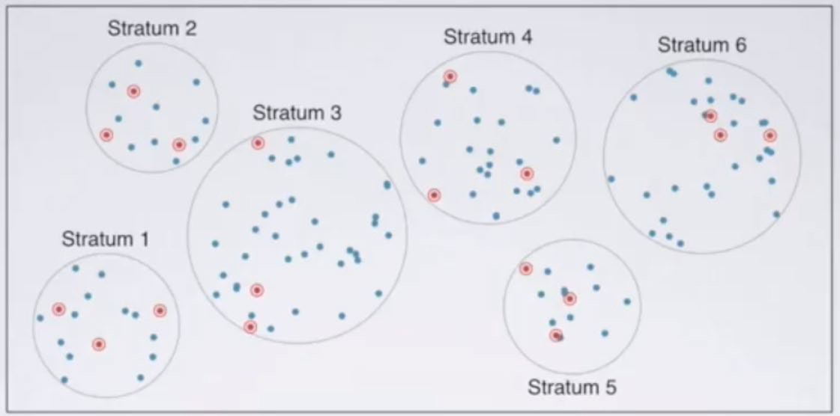
Stratified Sampling
Stratified Sample: Divide the population into homogenous groups, then randomly sample from each group.

Slide 26
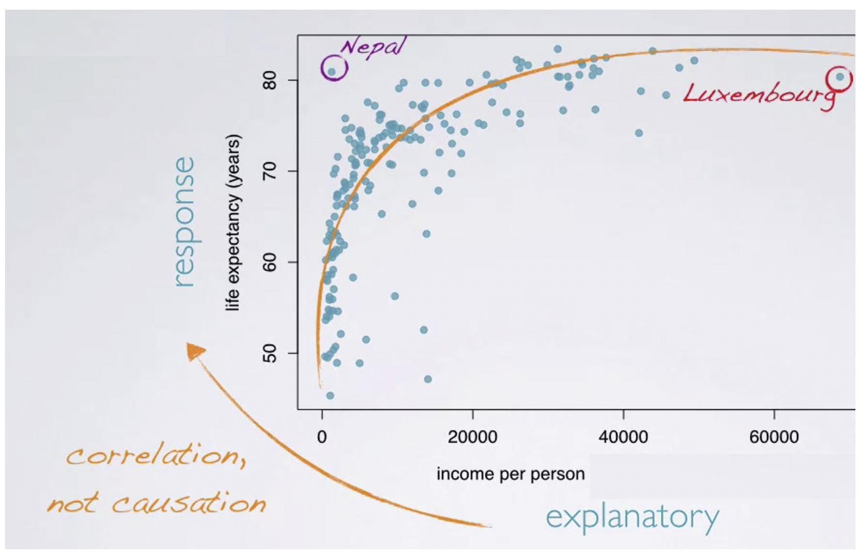
Scatterplot
outlier

Slide 27
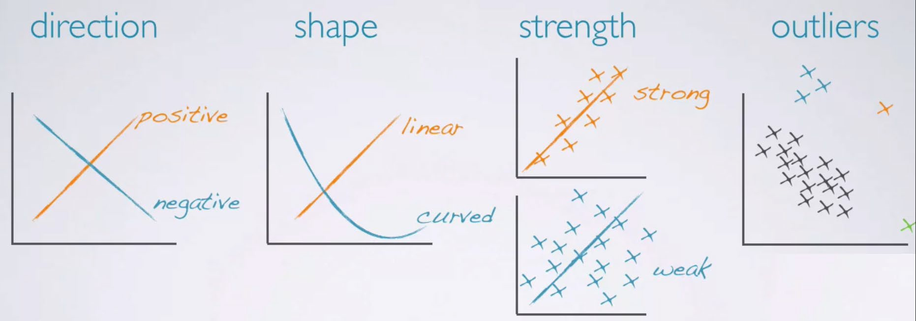
Evaluating the relationship

Slide 28
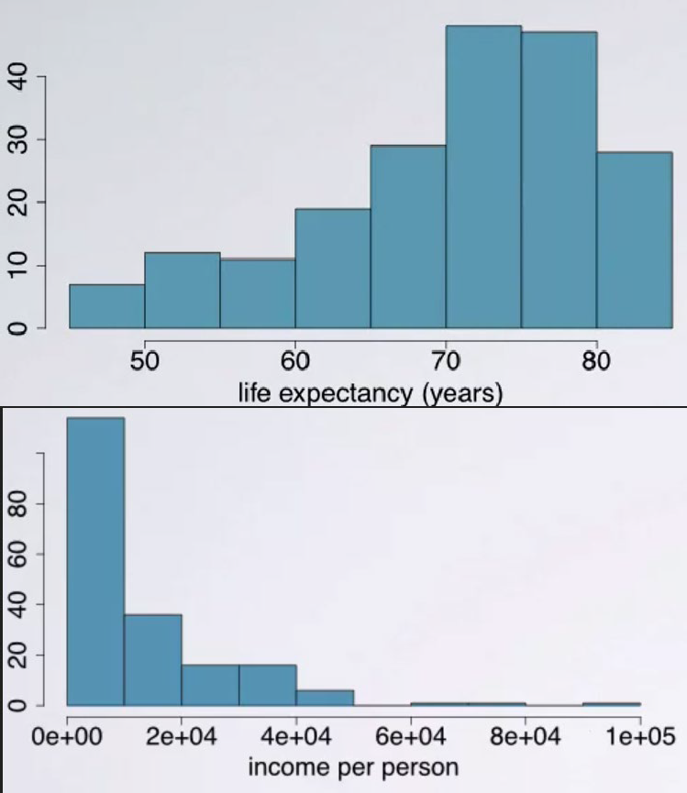
Histogram
Numerical variables.
Provides a view of the data density.
Especially useful for describing the shape of the distribution

Slide 29
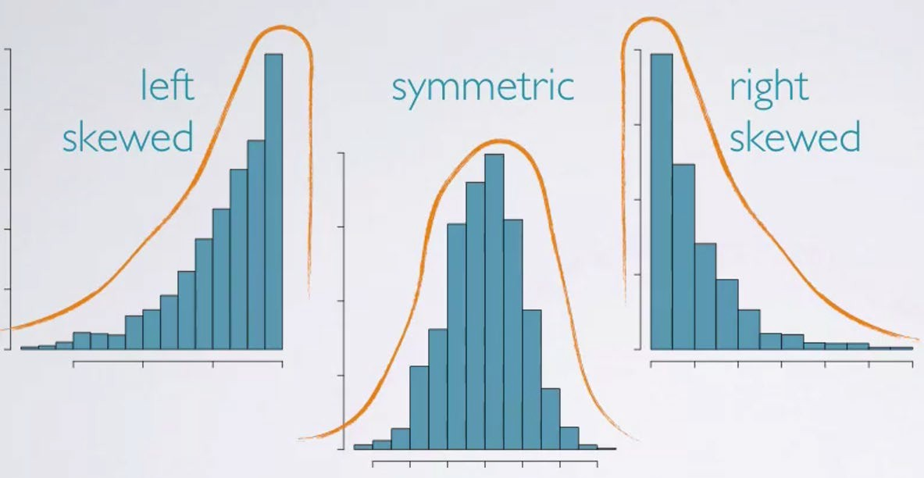
Skewness
Distributions are skewed to the side of the long tail.

Slide 30
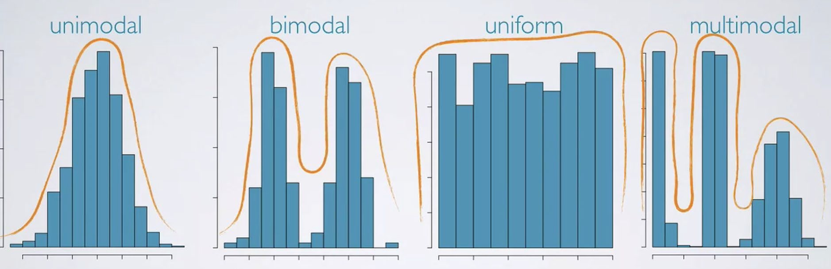
Modality

Slide 31
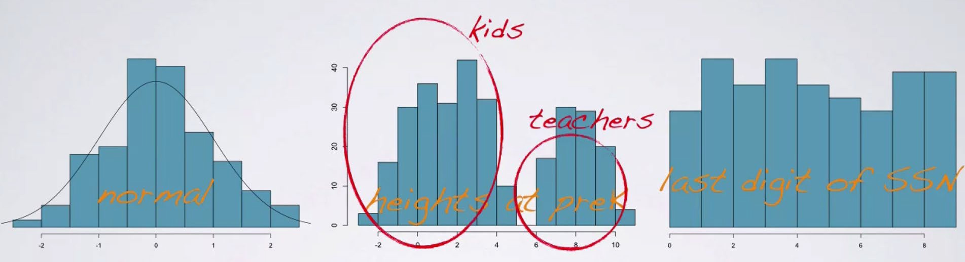
Modality

Slide 32
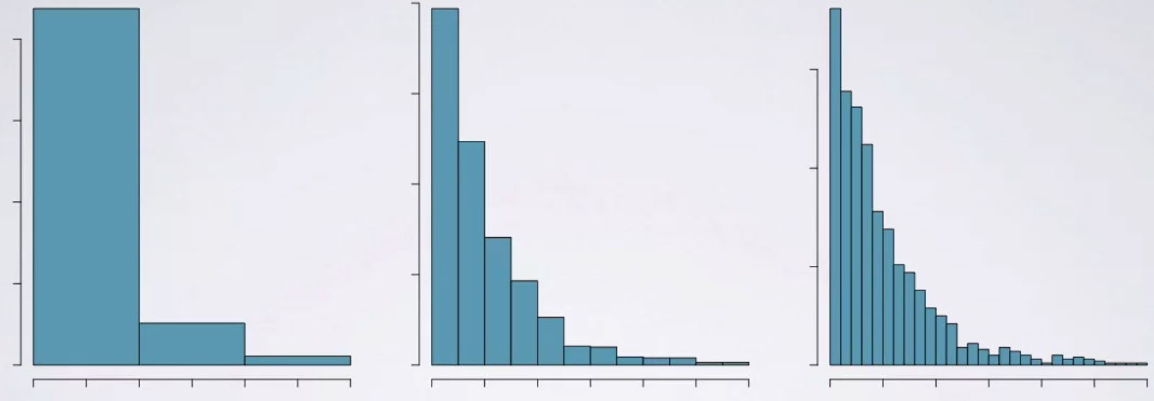
Histogram and Bin Width
The chosen bin width can alter the story the histogram is telling.
Binning turns numerical data into categorical data, based on ranges.

Slide 33
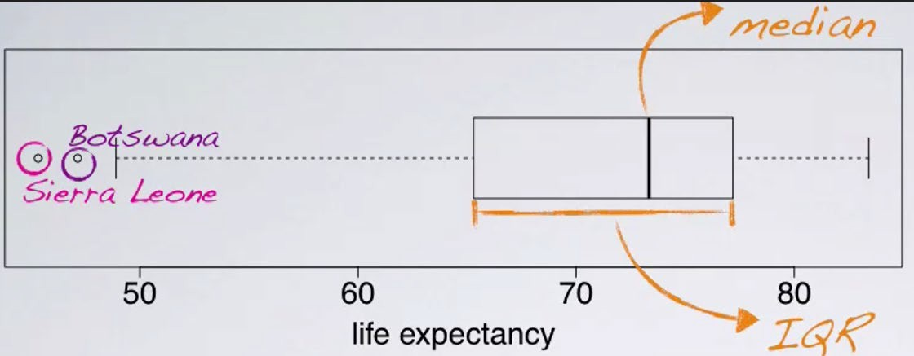
Box & Whisker plot
Useful for highlighting outliPrs, median, IQR.
Median: The mid point of the distribution.
IQR: interquartile range (middle half of the sample, Q3 & Q4)
Q1
Q2
Q3
Q4
excluding outliers

Slide 34
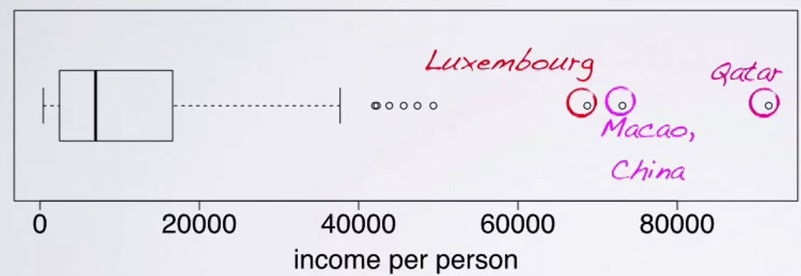
Box & Whisker plot
outliers

Slide 35
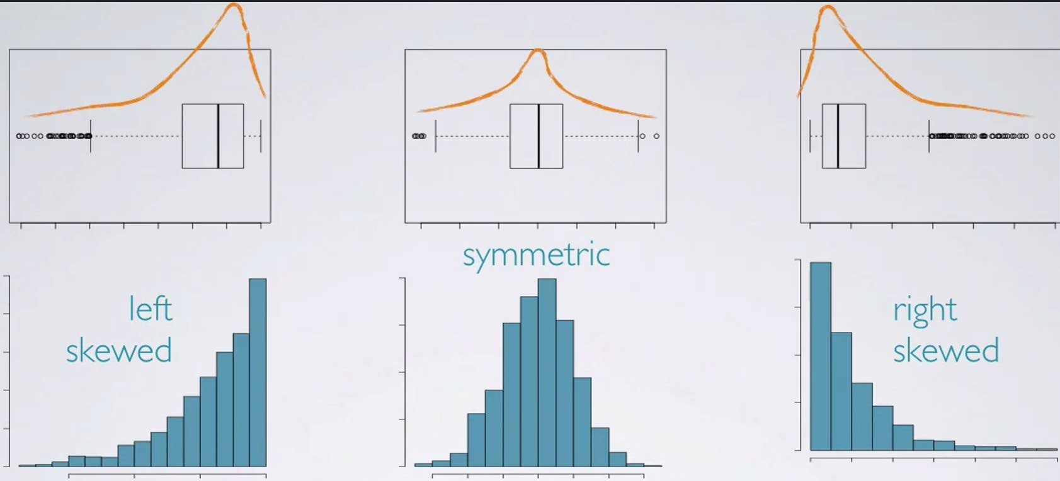
Box & Whisker plot

Slide 36
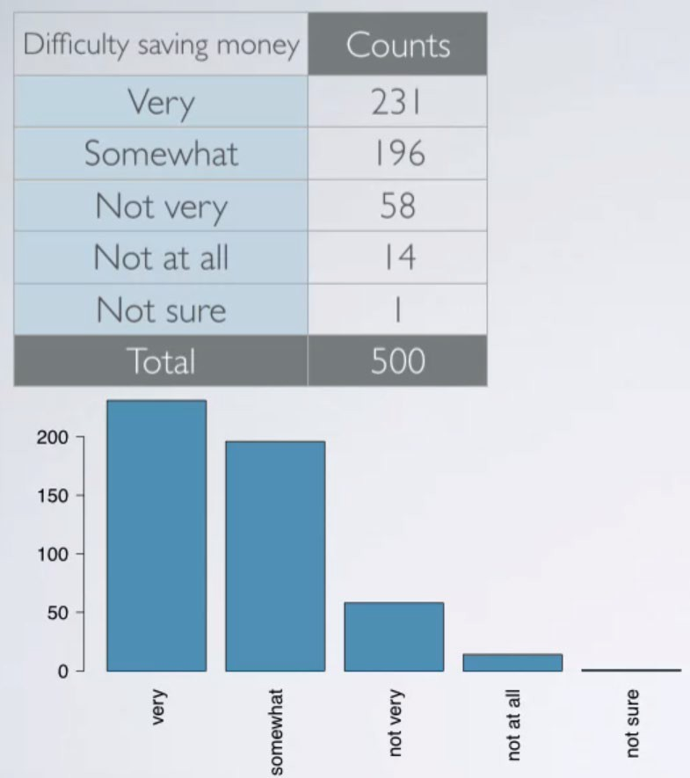
Distribution of a single categorical variable

Slide 37
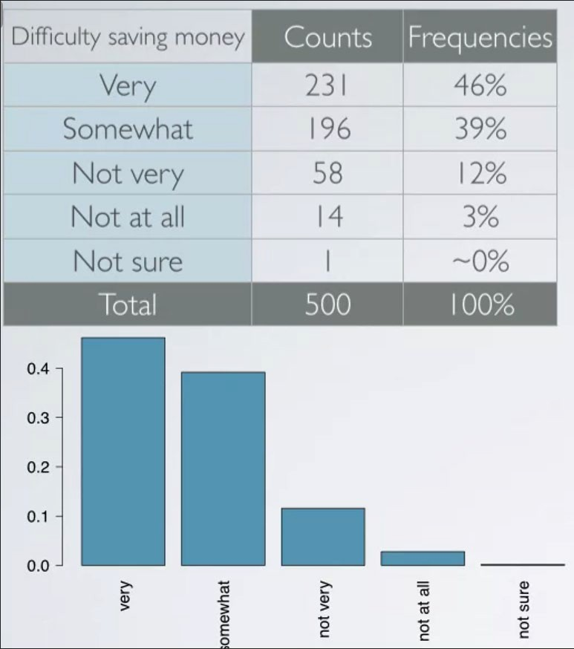
Frequency and bar plot
We usually consider the relative frequencies when evaluating the distributions of categorical variables.

Slide 38
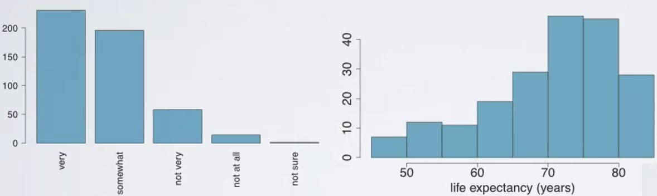
Bar graphs vs. Histograms
Bar plots/graphs are generally for categorical variables, histograms for numerical variables.
x-axis on a histogram is a number line and the ordering of the bars are not interchangeable.

Slide 39
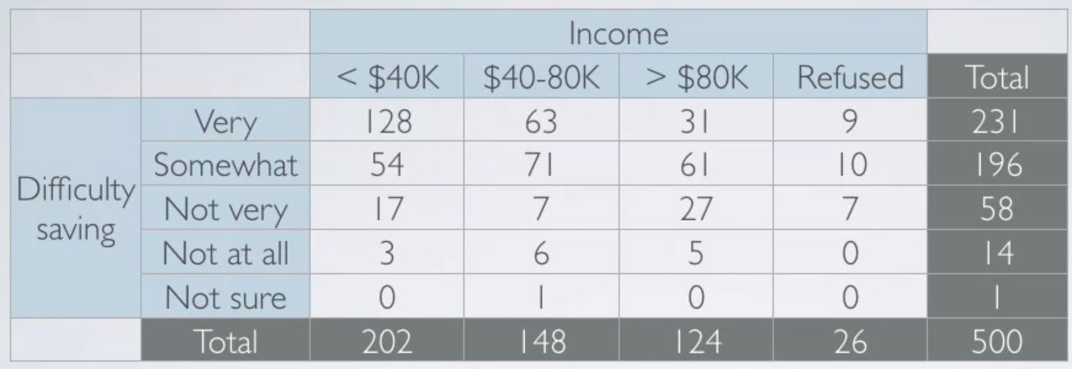
Contingency table
Evaluating the relationship between two categorical variables.
E.g.: whether people think it's difficult or easy to save money related to their income…

Slide 40
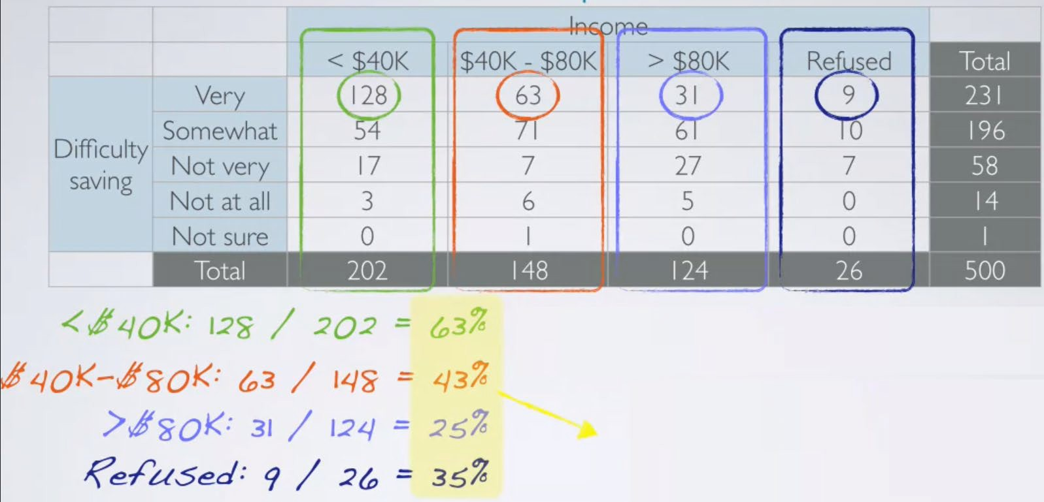
Relative Frequencies
feelings about difficulty of saving money and income are associated (dependent)

Slide 41
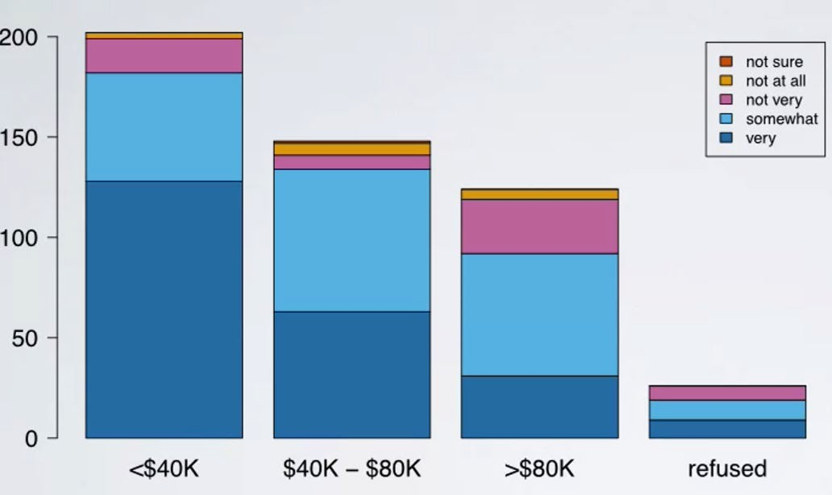
Segmented Bar plot
Useful for visualizing conditional frequency distributions.
Compare relative frequencies to explore the relationship between the variables.

Slide 42
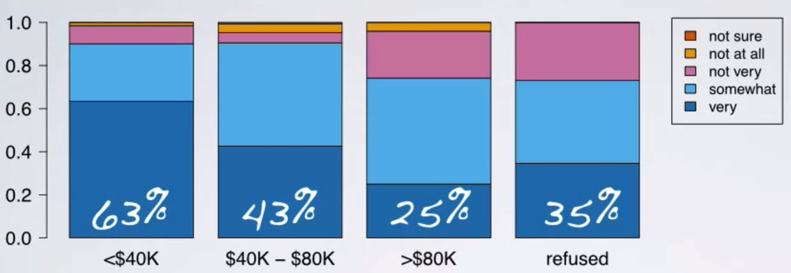
Relative Frequency Segmented Bar plot

Slide 43
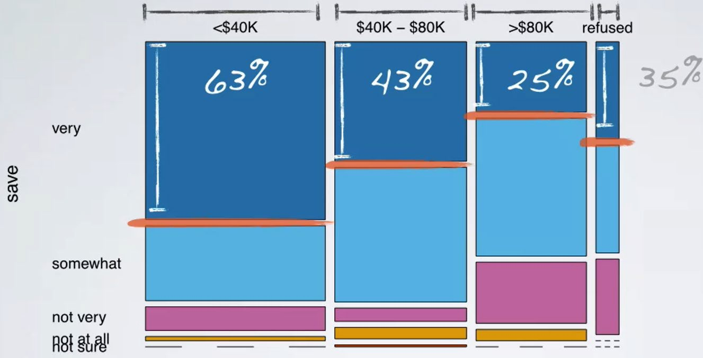
Mosaic plot

Slide 44
Evaluating the relationship between a categorical and a numerical variable
When comparing the distribution of a numerical variable across the levels of a categorical variable…

Slide 45
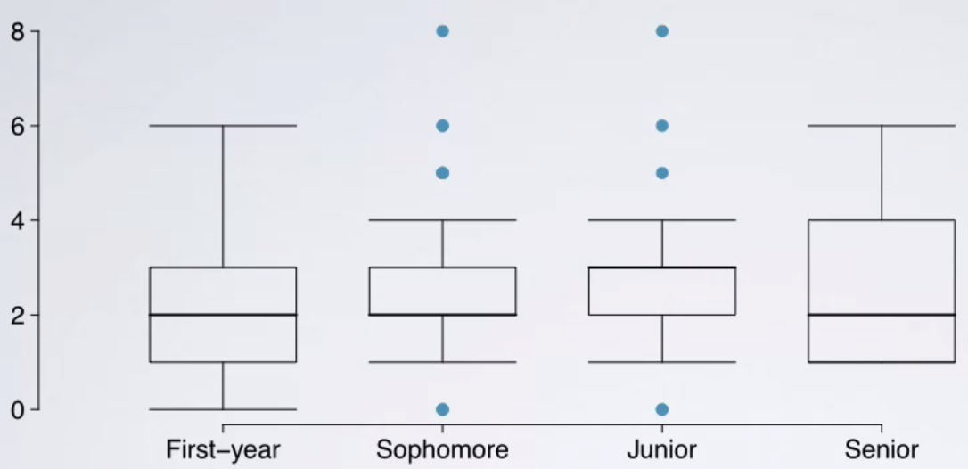
side-by-side box plots
The medians are consistent. The distributions across the class years are pretty similar, suggesting that number might be independent of their class year.

